Slide 1

Spfy: speedy predictive genomics
Supervisor: Chad Laing
Student: Kevin Le

Slide 2
Kevin Le
Currently:
BASc Software Engineering (uOttawa)
Focus on applied math
Co-op @NML Lethbridge (8-months)
Previously Completed:
BSc Neuroscience (Dalhousie)
Transgenic mouse models of Alzheimer’s
Cryptography & network security
Software Background:
Largely Python
Linux
Virtualization
Career Goals:
Big-data companies

Slide 3
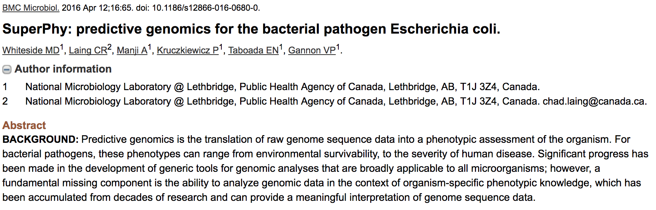
Background

Slide 4
The problem
Speed
Simplicity
Scalability
Predict serotype, VF, AMR within a few minutes
More responsive user-interface
Easier to upload genomes and get results
Intuitive navigation of the website
Quickly integrate new analyses & results
Ability to perform group comparisons across thousands of genomes

Slide 5
Challenges deep-dive
Goal: Speed
Predict serotype, VF, AMR within a few minutes
More responsive user-interface
Solution: Modernize
Docker
Task queues
ReactJS

Slide 6
Docker

Slide 7
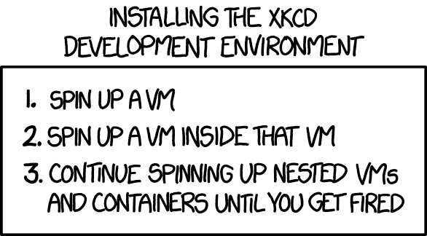
Docker

Slide 8





Solution
Flask API
Scalable uWSGI
Redis Container
Docker Volume
Redis DB
Redis Task Queue
Datafiles /datastore
RQ Worker Container
RQ Worker Container
RQ Worker Container
Priority Workers
4 Workers
Reg. Workers
12 Workers
UID Generation
1 Worker
Speed: task queues
Immediate Results

Slide 9
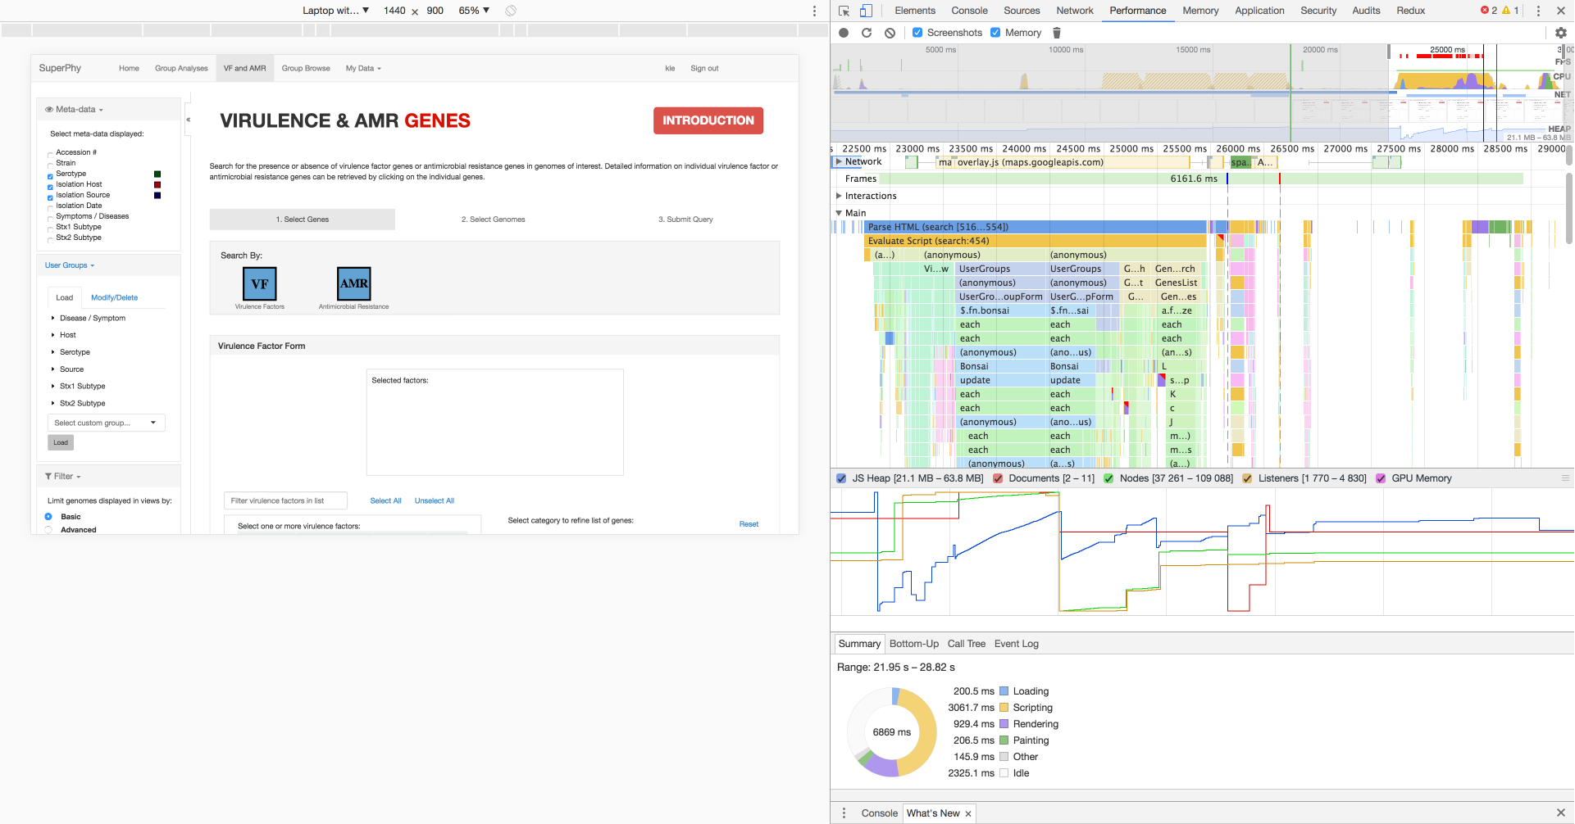

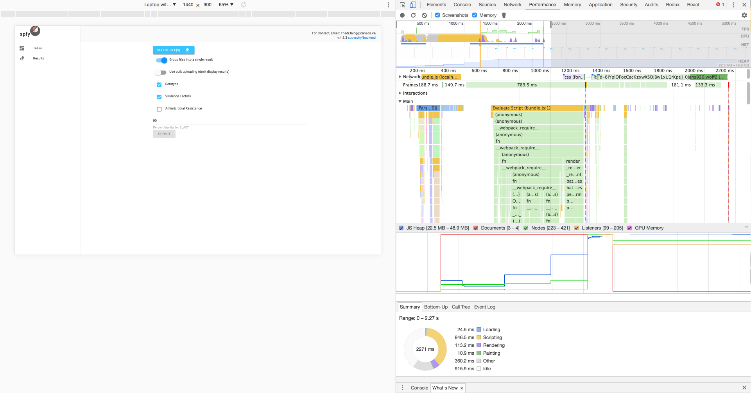
Solution
Speed: ReactJS

Slide 10



Solution
Webserver Container
Reverse Proxy
NGINX
Flask API
Scalable uWSGI
Scientist
Reactapp Container
Front-End
ReactJS
Speed: ReactJS
Docker

Slide 11
Challenges deep-dive
Goal: Simplicity
Easier to upload genomes and get results
Intuitive navigation of the website
Solution: Familiar Design
One click results
Material design (Google)

Slide 12
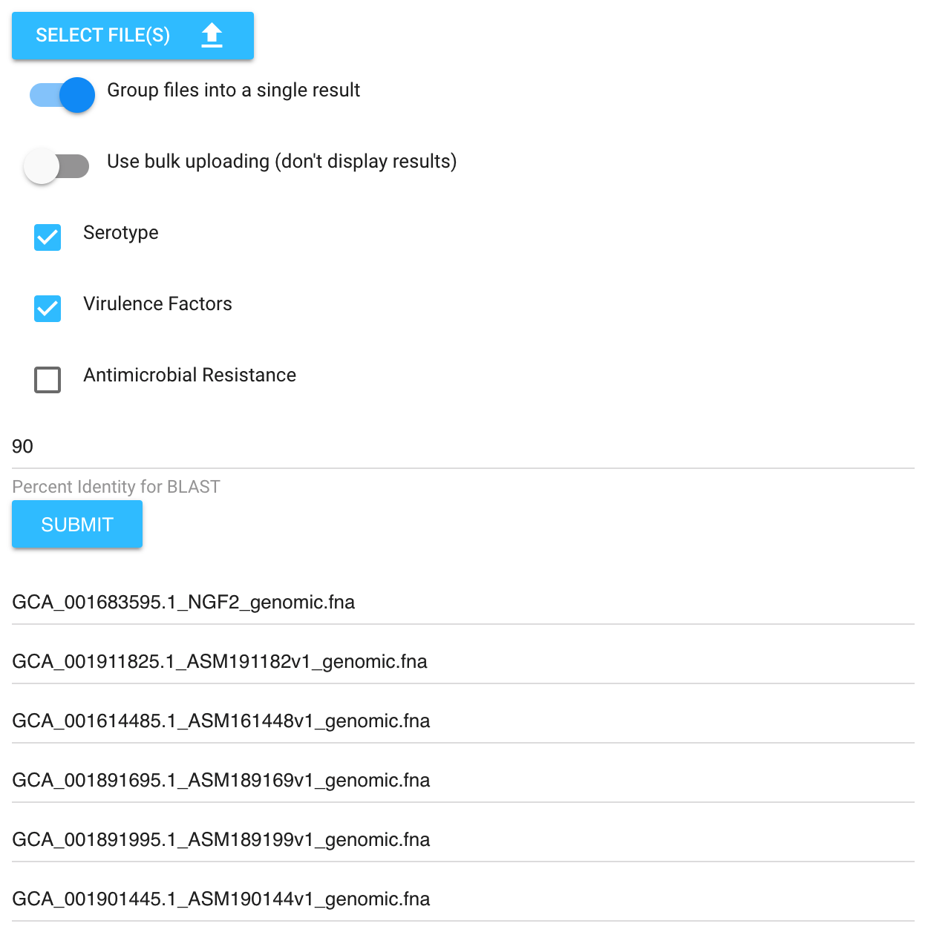
Solution
Simplicity: one-click results
Notes:
One of the benefits of our task queues, is that we can easily distribute work and just run for everything, not specific VFs or AMRs

Slide 13
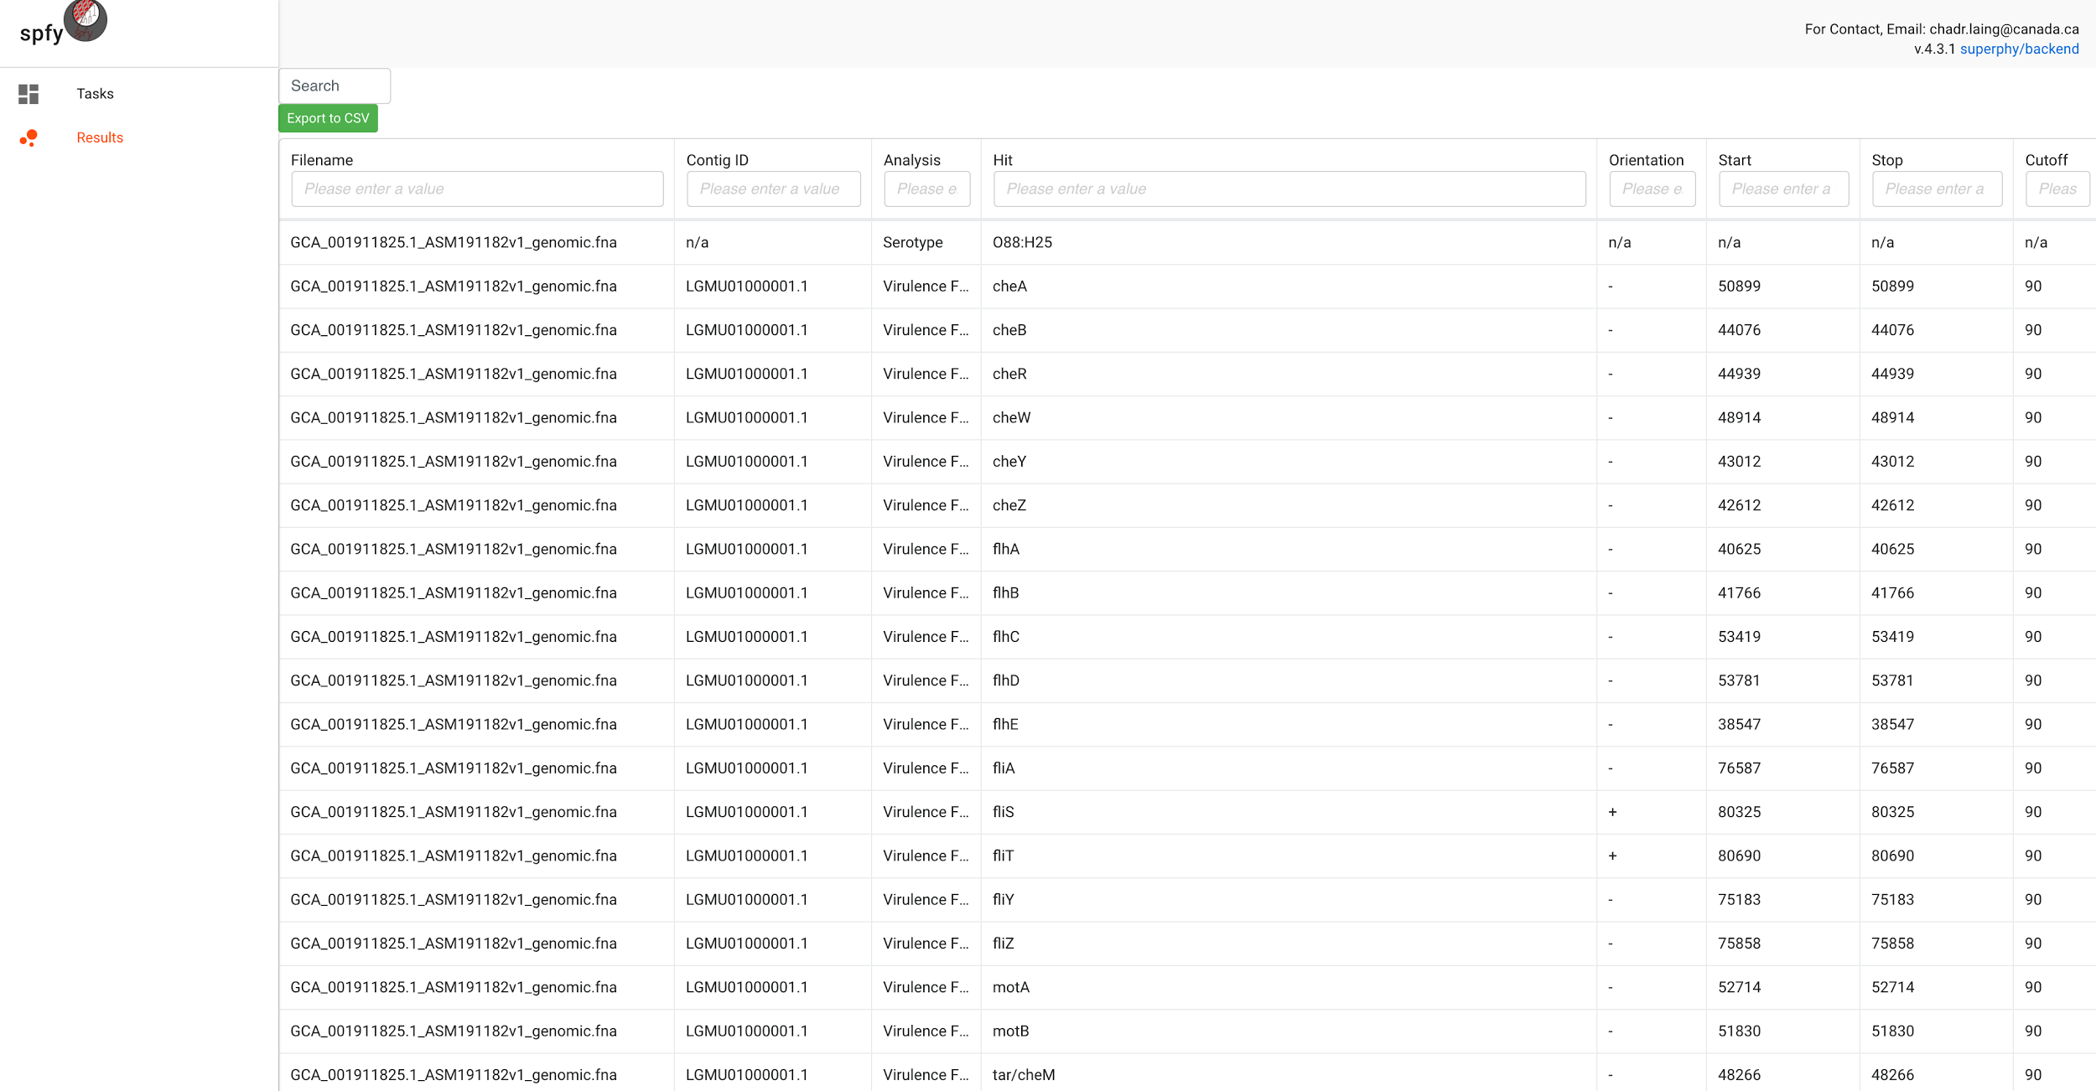
Solution
Simplicity: one-click results
Notes:
One of the benefits of our task queues, is that we can easily distribute work and just run for everything, not specific VFs or AMRs

Slide 14
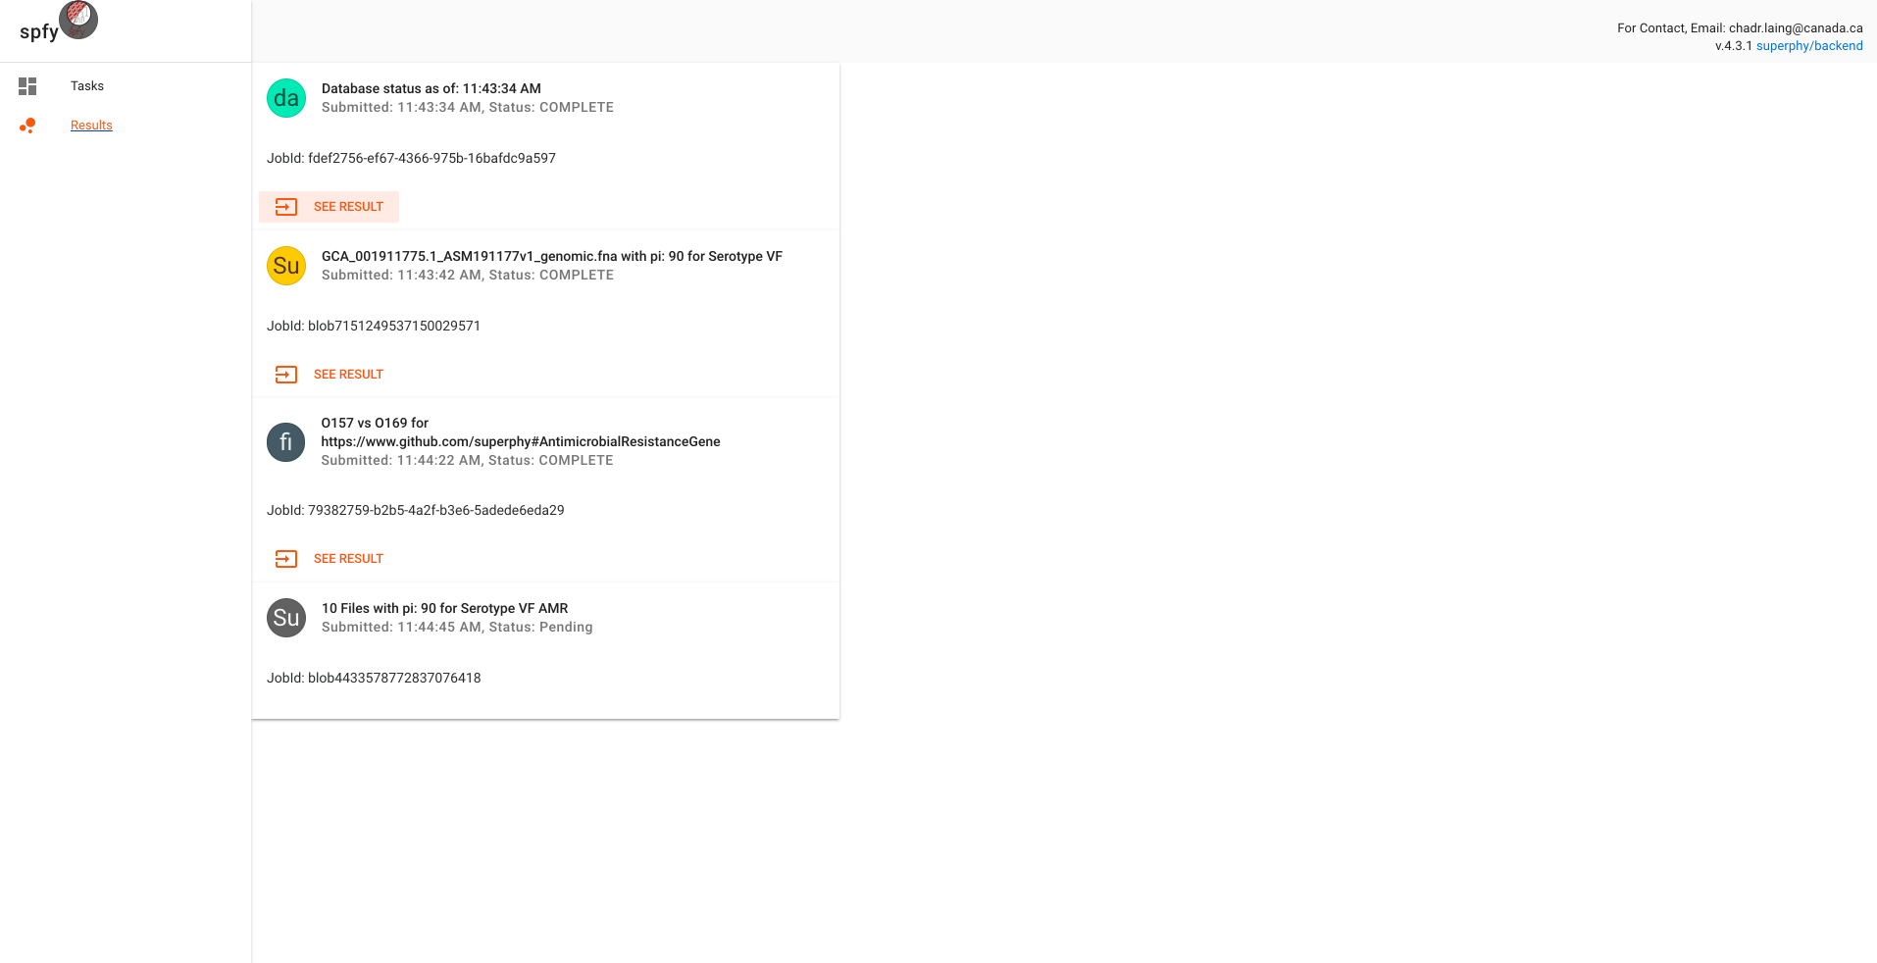
Solution
Simplicity: material design
Card Based
Notes:
Material Design: used by Google, familiar to users.
Card Based: You’ll see this card based design reused throughout.

Slide 15
Challenges deep-dive
Goal: Scalability
Quickly integrate new analyses & results
Ability to perform group comparisons across thousands of genomes
Solution: Technology
Graph database
Pandas, SciPy

Slide 16
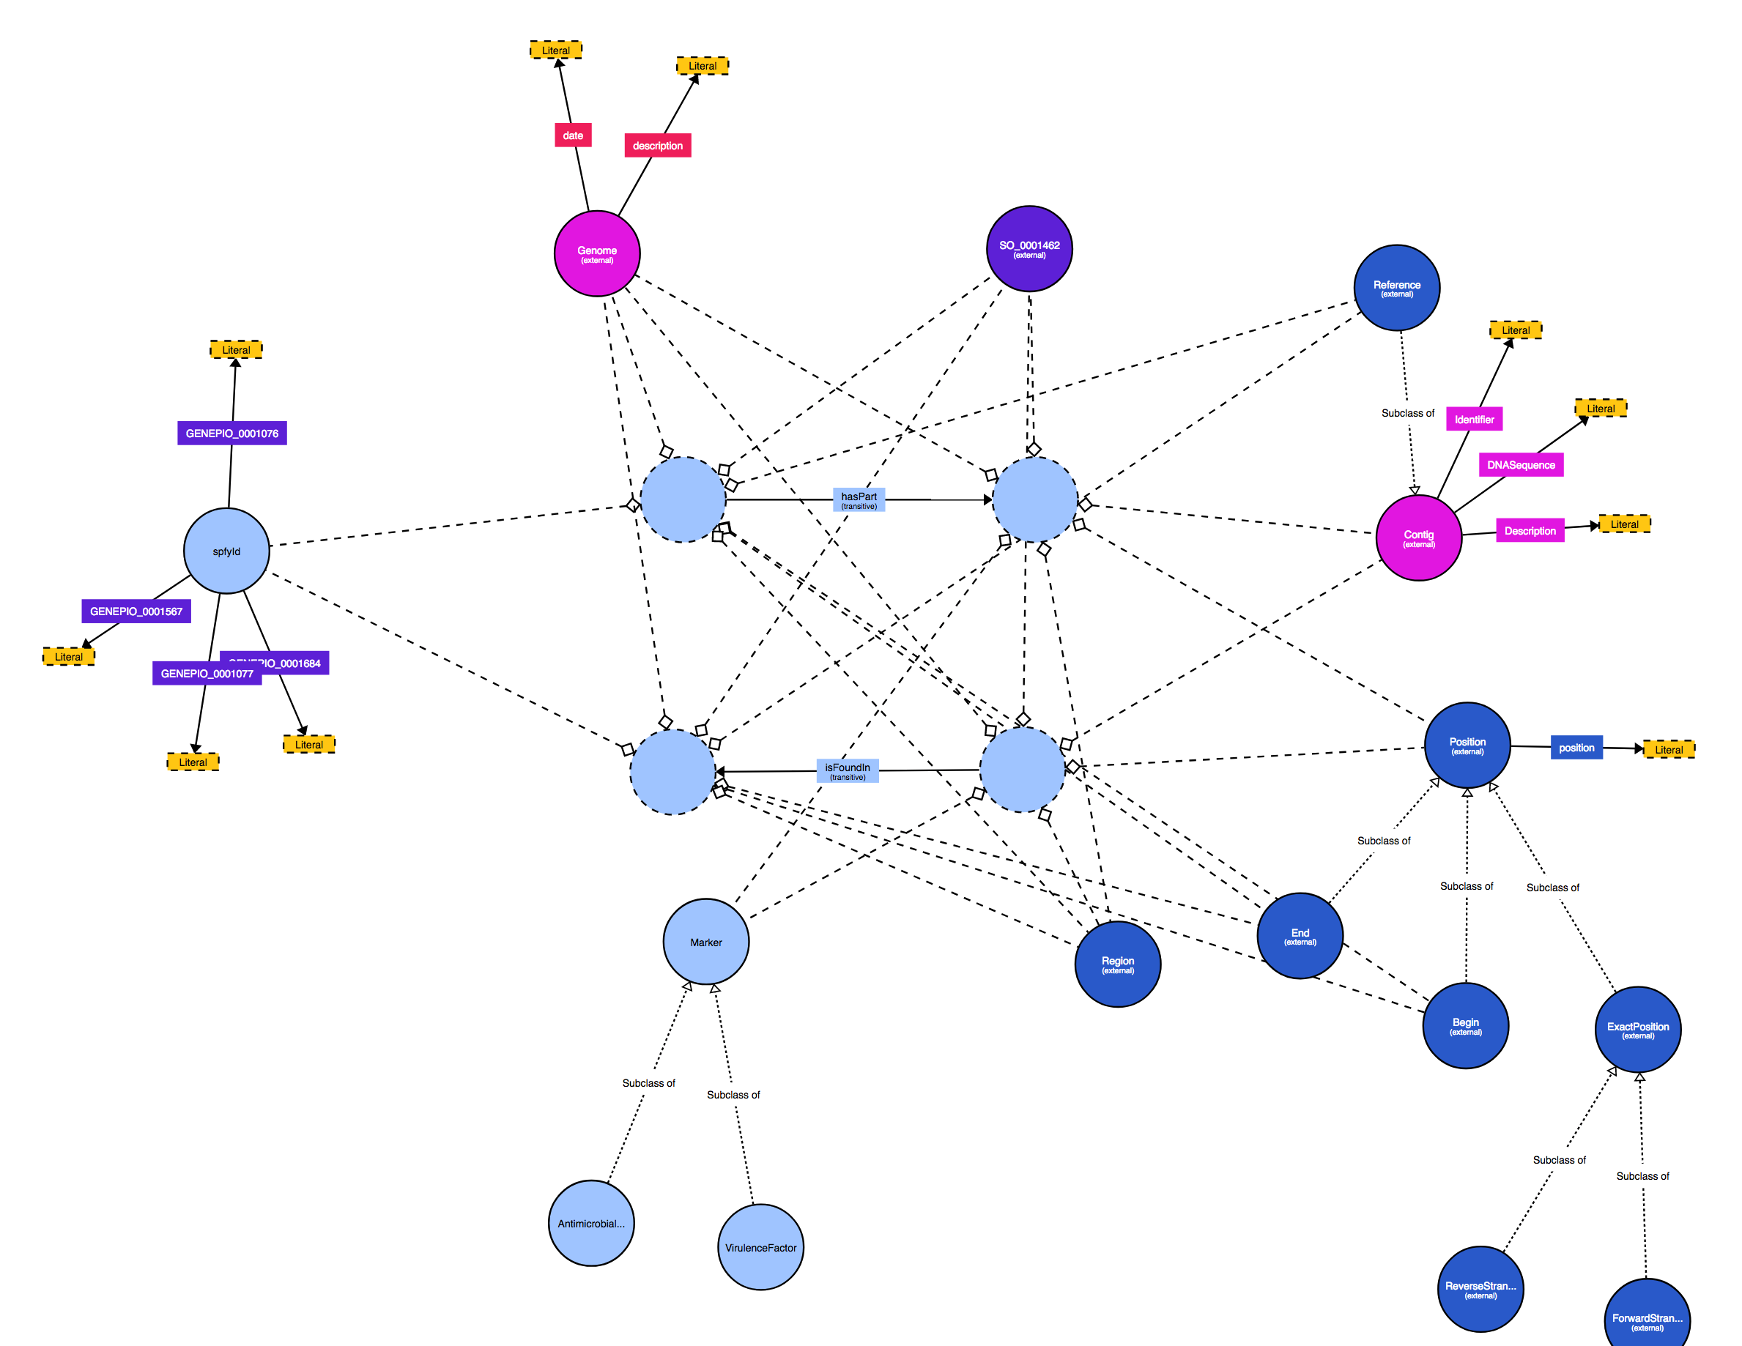
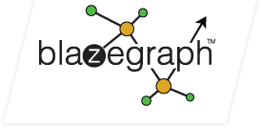
Solution
Scalability: graph database
Semantic Web
Notes:
Material Design: used by Google, familiar to users.
Card Based: You’ll see this card based design reused throughout.

Slide 17
Solution
Blazegraph Container (LTS)
Graph Database
Blazegraph
RQ Worker Container
RQ Worker Container
RQ Worker Container
Scalability: graph database
Priority Workers
4 Workers
Reg. Workers
12 Workers
UID Generation
1 Worker
Docker
Notes:
Material Design: used by Google, familiar to users.
Card Based: You’ll see this card based design reused throughout.

Slide 18


Solution
Scalability: pandas, scipy
Python Wrappers to C Code
Notes:
Material Design: used by Google, familiar to users.
Card Based: You’ll see this card based design reused throughout.

Slide 19
Challenges deep-dive
Speed
Simplicity
Scalability
Modernize
Task queues
ReactJS
Familiar Design
One click results
Material design (Google)
Technology
Graph database
Pandas, SciPy

Slide 20
Timeline

Slide 21
Wrapper for serotype, VF, AMR
Upload to graph database
Docker
QC / CI
Initial Deployment
January
February
March
April
Task queues
API (Flask)
Basic website (AngularJS)
Graph traversals
Group comparisons: backend code (Flask)

Slide 22
Implemented subtyping in React
Read the Docs
Paper writing
May
June
July
August
Group comparisons: frontend code (ReactJS)
2nd deployment
Refactor backend
Additional features
3rd deployment

Slide 23
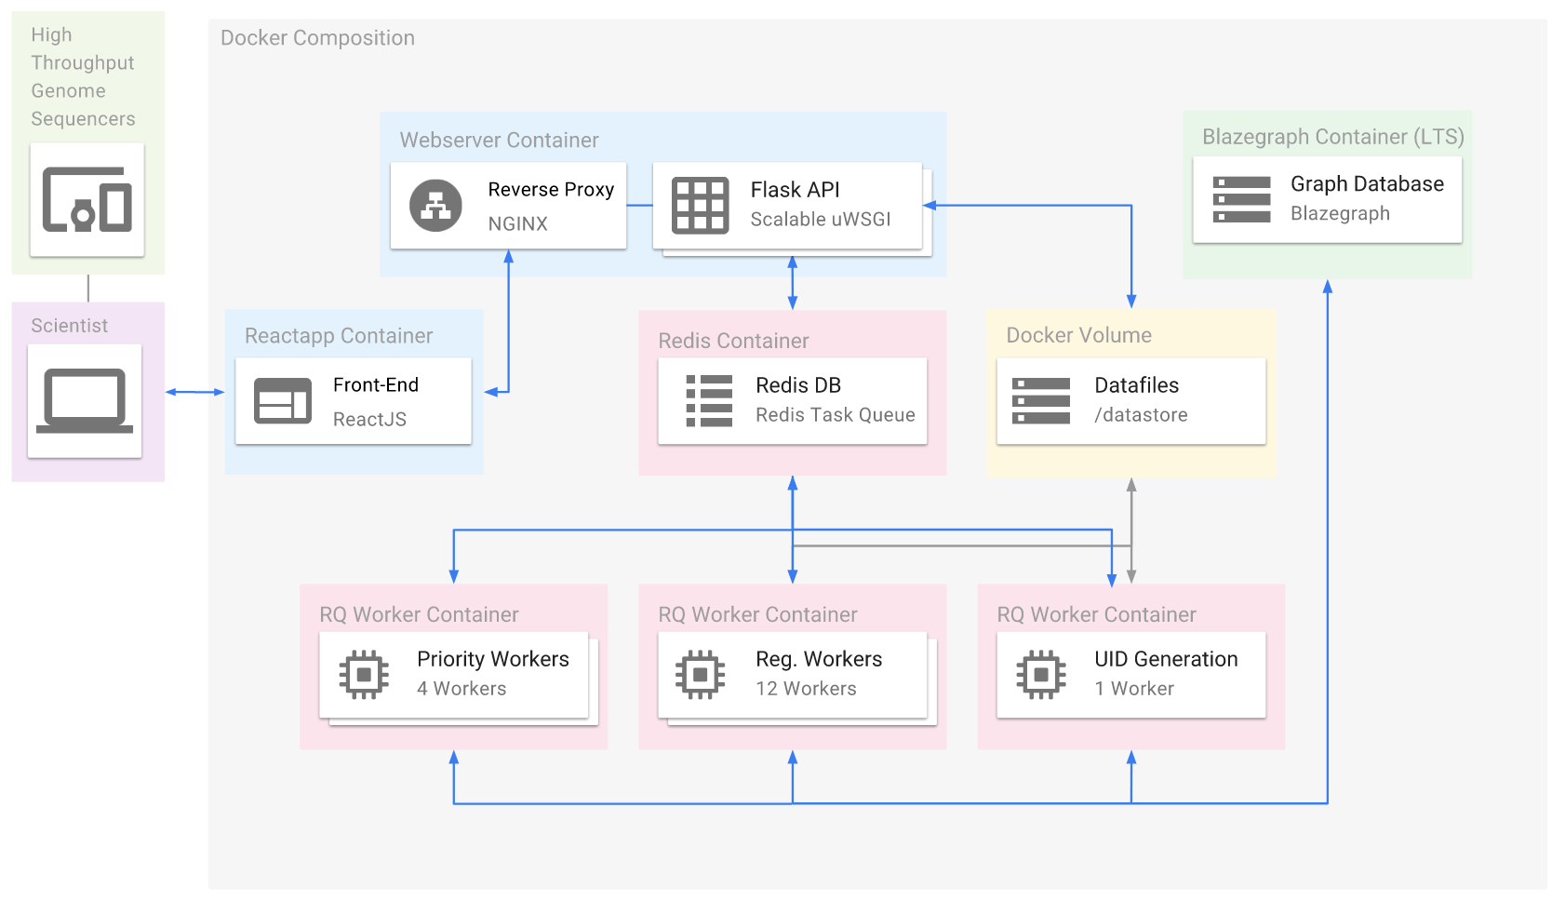
End Result
Platform Architecture

Slide 24
Live Demo

Slide 25
End Result:
Real-time serotype, VF, AMR prediction
Within 2-3 minutes
Storage and retrieval of genomes & results in a Graph Database
Test set: 5353 GenBank genomes
Live group comparisons of database entries within seconds
Ex. O157 vs O53 for all known VFs

